Slide 1
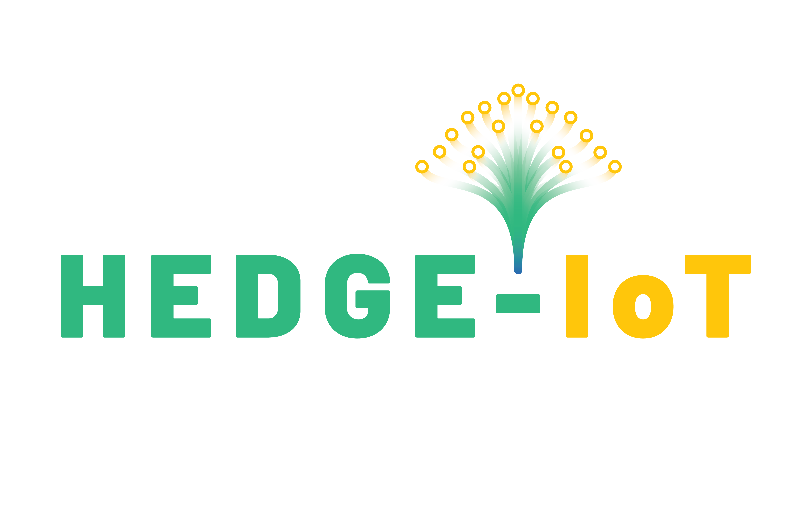



HEDGE-IoT
Orchestration of AI driven Energy Services Across the Computational Continuum
Tudor Cioara
This project has received funding from the European Union's Horizon Europe research and innovation programme under the Grant Agreement number 101136216. Views and opinions expressed are however those of the author(s) only and do not necessarily reflect those of the European Union or the European Climate, Infrastructure and Environment Executive Agency. Neither the European Union nor the granting authority can be held responsible for them.

Slide 2
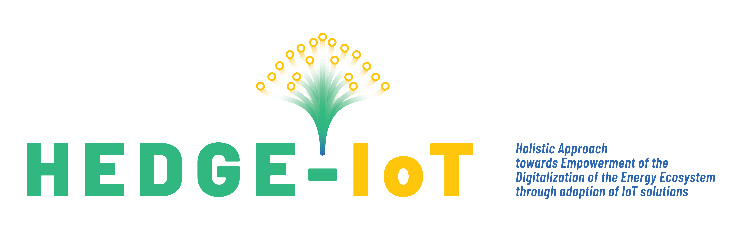
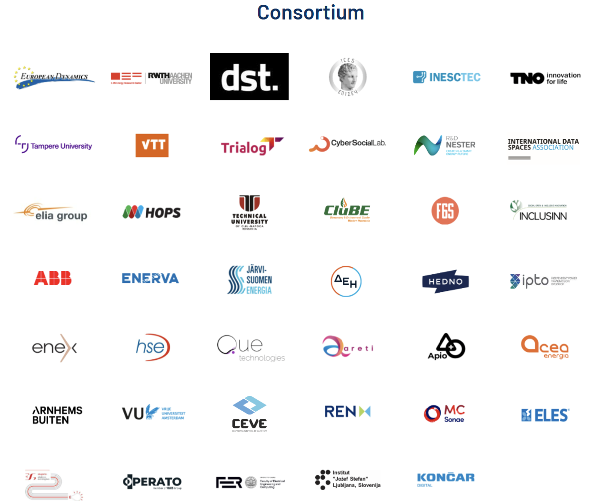
About HEDGE-IoT
HORIZON-CL5-2023-D3-01-15
Supporting the green and digital transformation of the energy ecosystem and enhancing its resilience through the development and piloting of AI-IoT Edge-cloud and platform solutions
Project Grant Agreement: No. 101136216
Project Coordinator: European Dynamics Luxembourg SA
Budget: 21.9 M Euro
Duration: 42 months
Start Date: 1st January 2024

Slide 3
Vision & Objectives
To add local/distributed intelligence leveraging IoT solutions at the edge/fog/cloud layers establishing the edge/cloud continuum through computational orchestration
To design AI/ML tools for edge/fog/cloud services for increased flexibility, resilience and observability
To enable extended service and semantical/ontological interoperability and interconnectivity among distributed open platforms, systems and edge devices through a decentralized IDS-compliant Interoperability Framework
6 Demonstrators in 6 European countries featuring different climatic, regulatory and societal conditions towards maximizing mutual learning and knowledge exchange
To facilitate the market uptake of the proposed solutions, strengthening their commercialization potential and contributing to the Digitalization of Energy Action Plan.
To apply and extend open standards for IoT, interoperability, grid and market related data exchanges and to create a set of commonly accepted standards
Holistic Approach towards Empowerment of the DiGitalization of the Energy Ecosystem through adoption of IoT solutions
Deploy IoT assets at different levels of the energy system (from behind-the-meter, up to the TSO level)
Add intelligence to the edge and cloud layers
Bridge the cloud/edge continuum introducing federated applications governed by advanced computational orchestration solutions.

Slide 4
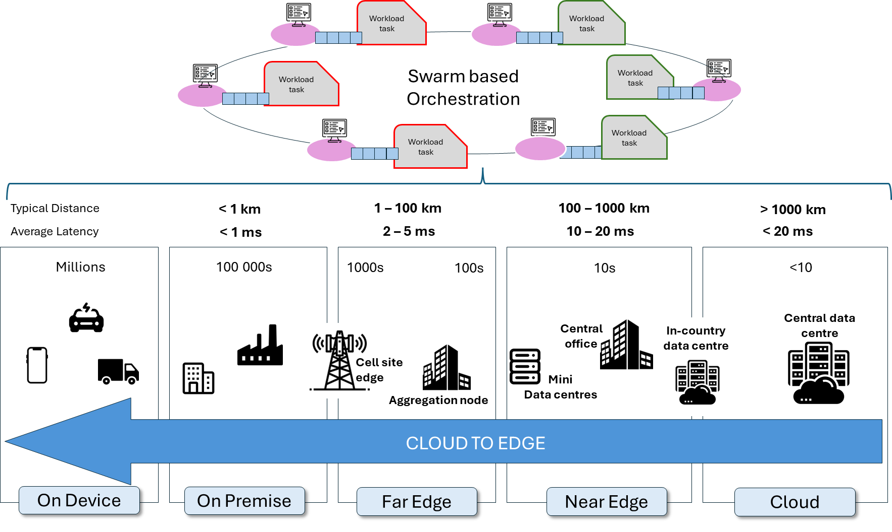
Context and Motivation
Real-time
Energy Services
Requires instant response
Cloud
Computing
High-Power, High-Latency
Centralization of computational resources
Dependent on stable network conditions
AI/ML processes
Computing Paradigm Shift
Data-intensive
IoT driven energy grid
Generates massive data volumes

Slide 5
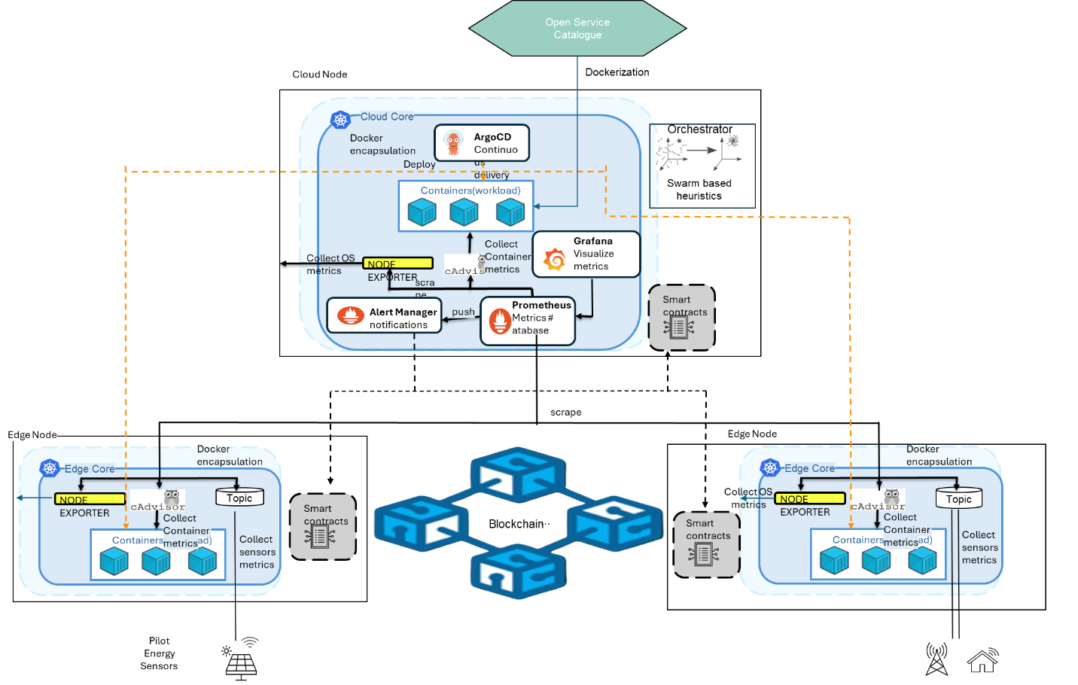
Orchestrator Architecture
Use case 1: Non-AI dockerized energy services
Objective: enable improved data processing and reducing latency at the network's edge.
Prometheus for observability
Swarm heuristics for decision making
Blockchain for offloading notarization

Slide 6
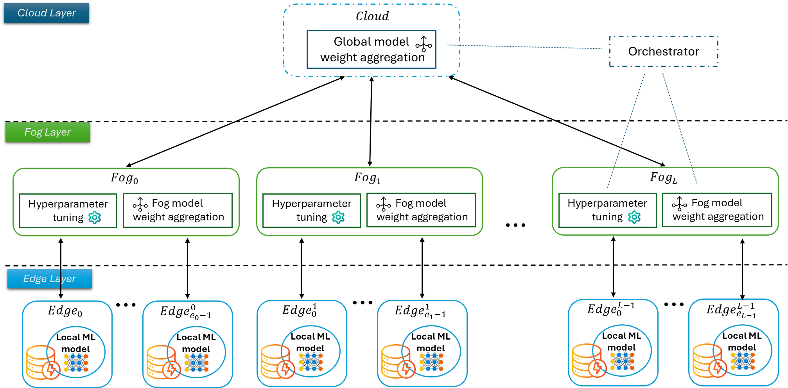
Orchestrator Architecture
Use case 2: AI driven federated energy services
Objective: Minimize data transfer overhead in federated AI services by optimizing the hyperparameters of the learning process
Hierarchical vs P2P federated model

Slide 7
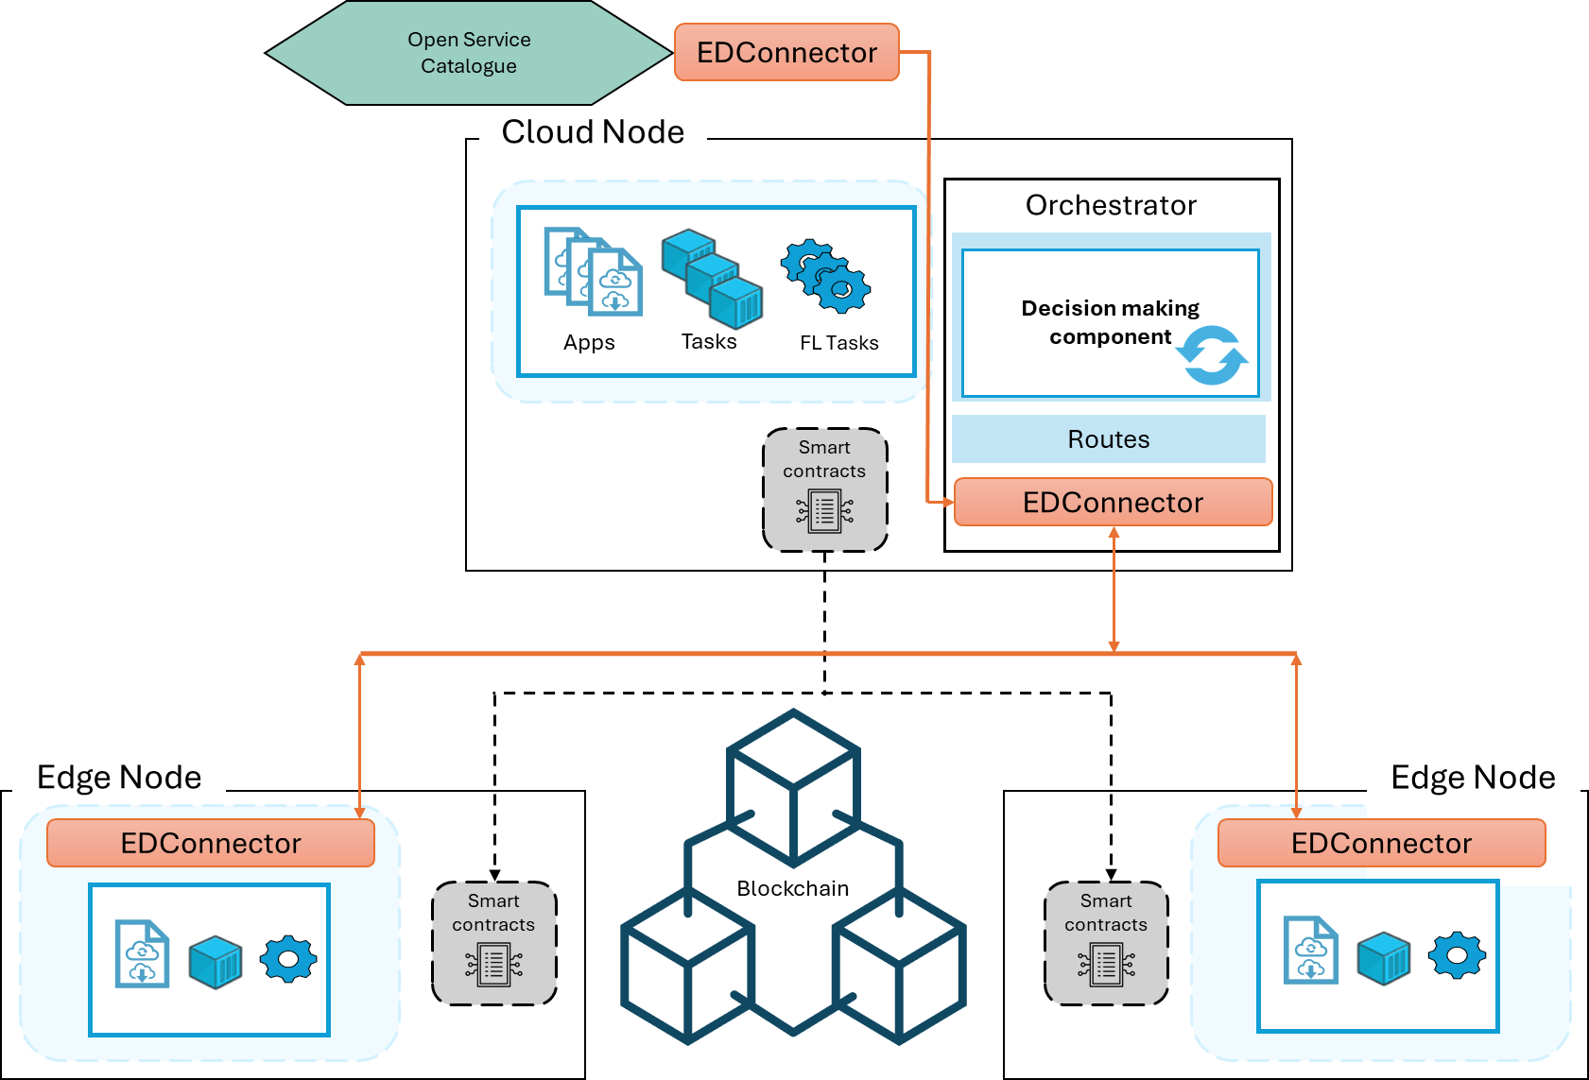
Interoperability via Energy Data Spaces
Eclipse data space connector integration
Exchange data and meta-data
Open services catalogue
Data interoperability and semantic interoperability

Slide 8

THANK YOU!!
This project has received funding from the European Union’s Horizon Europe research and innovation programme under grant agreement No 101136216

